Slide 1
Introduction to Probability and Statistics
Twelfth Edition
Robert J. Beaver • Barbara M. Beaver • William Mendenhall
Presentation designed and written by:
Barbara M. Beaver

Slide 2
Introduction to Probability and Statistics
Twelfth Edition
Chapter 4
Probability and Probability Distributions
Some graphic screen captures from Seeing Statistics ®
Some images © 2001-(current year) www.arttoday.com

Slide 3
What is Probability?
In Chapters 2 and 3, we used graphs and numerical measures to describe data sets which were usually samples.
We measured “how often” using
Relative frequency = f/n
As n gets larger,
Sample
And “How often”
= Relative frequency
Population
Probability

Slide 4
Basic Concepts
An experiment is the process by which an observation (or measurement) is obtained.
Experiment: Record an age
Experiment: Toss a die
Experiment: Record an opinion (yes, no)
Experiment: Toss two coins

Slide 5
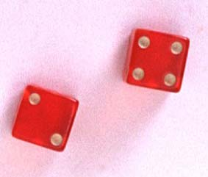
Basic Concepts
A simple event is the outcome that is observed on a single repetition of the experiment.
  The basic element to which probability is applied.
  One and only one simple event can occur when the experiment is performed.
A simple event is denoted by E with a subscript.

Slide 6
Basic Concepts
Each simple event will be assigned a probability, measuring “how often” it occurs.
The set of all simple events of an experiment is called the sample space, S.

Slide 7

Example
The die toss:
Simple events: Sample space:
1
E₁
E₂
E₃
E₄
E₅
E₆
S ={E₁, E₂, E₃, E₄, E₅, E₆}
2
S
3
E₁
E₃
4
E₅
5
E₂
E₆
E₄
6

Slide 8
Basic Concepts
An event is a collection of one or more simple events.
S
E₁
E₃
The die toss:
  A: an odd number
  B: a number > 2
A
E₅
B
E₂
E₆
E₄
A ={E₁, E₃, E₅}
B ={E₃, E₄, E₅, E₆}

Slide 9
Basic Concepts
Two events are mutually exclusive if, when one event occurs, the other cannot, and vice versa.
Experiment: Toss a die
  A: observe an odd number
  B: observe a number greater than 2
  C: observe a 6
  D: observe a 3
Not Mutually Exclusive
B and C?
B and D?
Mutually Exclusive

Slide 10
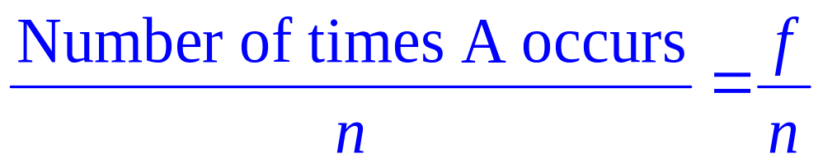
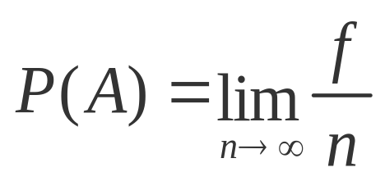
The Probability of an Event
The probability of an event A measures “how often” we think A will occur. We write P(A).
Suppose that an experiment is performed n times. The relative frequency for an event A is
If we let n get infinitely large,

Slide 11
The Probability of an Event
P(A) must be between 0 and 1.
  If event A can never occur, P(A) = 0. If event A always occurs when the experiment is performed, P(A) =1.
The sum of the probabilities for all simple events in S equals 1.
The probability of an event A is found by adding the probabilities of all the simple events contained in A.

Slide 12
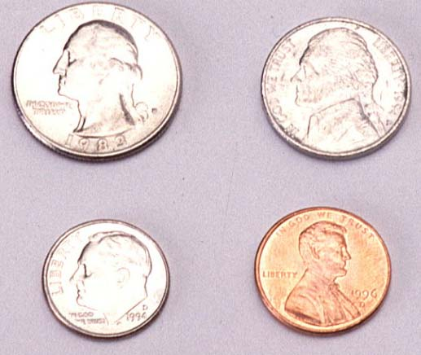
Finding Probabilities
Probabilities can be found using
  Estimates from empirical studies
  Common sense estimates based on equally likely events.
Examples:
  Toss a fair coin.
P(Head) = 1/2
10% of the U.S. population has red hair. Select a person at random.
P(Red hair) = .10

Slide 13
Example
Toss a fair coin twice. What is the probability of observing at least one head?
1st Coin 2nd Coin E_{i} P(E_{i})
H
HH
1/4
1/4
1/4
1/4
P(at least 1 head)
= P(E₁) + P(E₂) + P(E₃)
= 1/4 + 1/4 + 1/4 = 3/4
H
T
HT
H
TH
T
T
TT

Slide 14
Example
A bowl contains three M&Ms®, one red, one blue and one green. A child selects two M&Ms at random. What is the probability that at least one is red?
1st M&M 2nd M&M E_{i} P(E_{i})
m
RB
1/6
1/6
1/6
1/6
1/6
1/6
m
m
RG
P(at least 1 red)
= P(RB) + P(BR)+ P(RG) + P(GR)
= 4/6 = 2/3
m
BR
m
m
BG
m
GB
m
m
GR

Slide 15
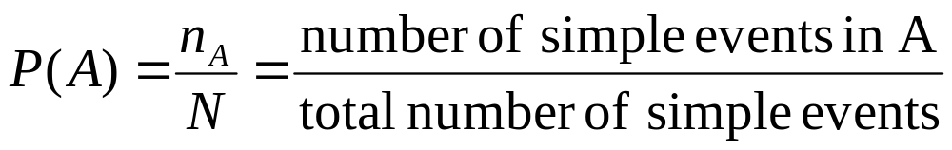
Counting Rules
If the simple events in an experiment are equally likely, you can calculate
You can use counting rules to find n_{A} and N.

Slide 16
The mn Rule
If an experiment is performed in two stages, with m ways to accomplish the first stage and n ways to accomplish the second stage, then there are mn ways to accomplish the experiment.
This rule is easily extended to k stages, with the number of ways equal to
  n₁ n₂ n₃ … n_{k}
Example: Toss two coins. The total number of simple events is:
2 × 2 = 4

Slide 17

Examples
m
m
Example: Toss three coins. The total number of simple events is:
2 × 2 × 2 = 8
Example: Toss two dice. The total number of simple events is:
6 × 6 = 36
Example: Two M&Ms are drawn from a dish containing two red and two blue candies. The total number of simple events is:
4 × 3 = 12

Slide 18

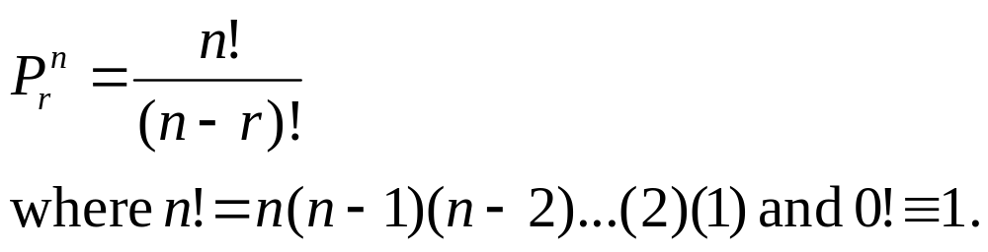
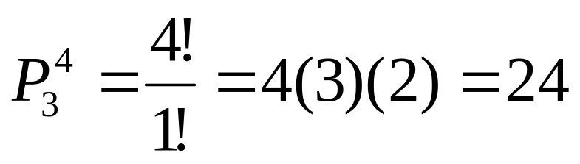
Permutations
The number of ways you can arrange
n distinct objects, taking them r at a time is
Example: How many 3-digit lock combinations can we make from the numbers 1, 2, 3, and 4?
The order of the choice is important!

Slide 19
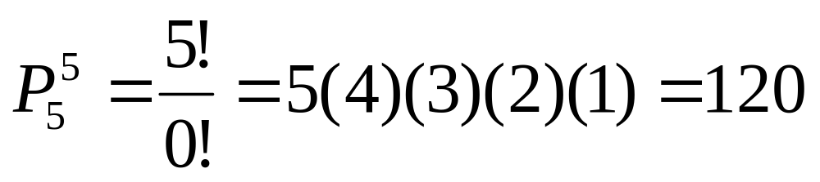
Examples
Example: A lock consists of five parts and can be assembled in any order. A quality control engineer wants to test each order for efficiency of assembly. How many orders are there?
The order of the choice is important!

Slide 20
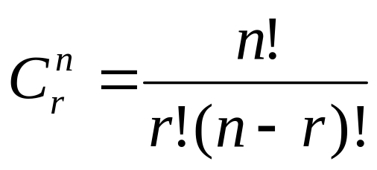
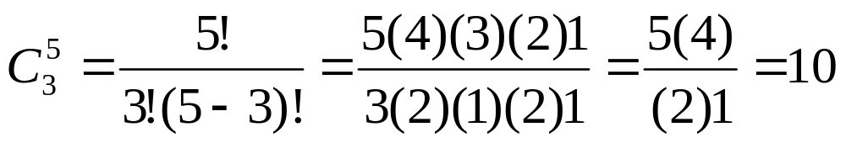
Combinations
The number of distinct combinations of n distinct objects that can be formed, taking them r at a time is
Example: Three members of a 5-person committee must be chosen to form a subcommittee. How many different subcommittees could be formed?
The order of
the choice is
not important!

Slide 21
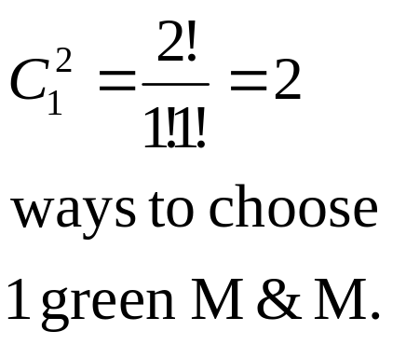
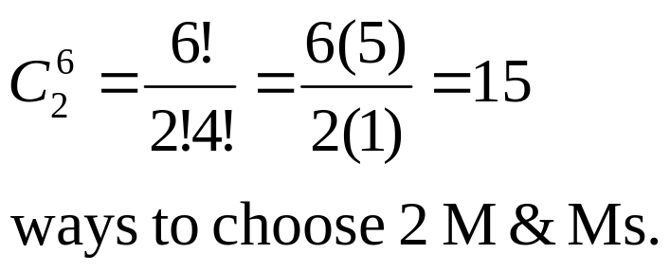
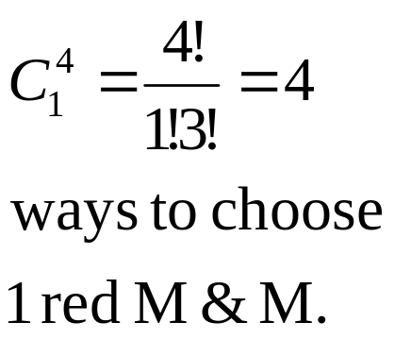
Example
m
m
m
m
m
m
A box contains six M&Ms®, four red
and two green. A child selects two M&Ms at random. What is the probability that exactly one is red?
The order of
the choice is
not important!
4 × 2 =8 ways to choose 1 red and 1 green M&M.
P( exactly one red) = 8/15

Slide 22

Event Relations
The union of two events, A and B, is the event that either A or B or both occur when the experiment is performed. We write
A ∪ B
S
A
B

Slide 23

Event Relations
The intersection of two events, A and B, is the event that both A and B occur when the experiment is performed. We write A ∩ B.
S
A
B
If two events A and B are mutually exclusive, then P(A ∩ B) = 0.

Slide 24
Event Relations
The complement of an event A consists of all outcomes of the experiment that do not result in event A. We write A^{C}.
S
A^{C}
A

Slide 25

Example
Select a student from the classroom and
record his/her hair color and gender.
  A: student has brown hair
  B: student is female
  C: student is male
Mutually exclusive; B = C^{C}
What is the relationship between events B and C?
A^{C}:
B∩C:
B∪C:
Student does not have brown hair
Student is both male and female = ∅
Student is either male and female = all students = S

Slide 26
Calculating Probabilities for Unions and Complements
There are special rules that will allow you to calculate probabilities for composite events.
The Additive Rule for Unions:
For any two events, A and B, the probability of their union, P(A ∪ B), is
A
B

Slide 27

Example: Additive Rule
Example: Suppose that there were 120 students in the classroom, and that they could be classified as follows:
A: brown hair
P(A) = 50/120
B: female
P(B) = 60/120
 | Brown | Not Brown
Male | 20 | 40
Female | 30 | 30
P(A∪B) = P(A) + P(B) – P(A∩B)
= 50/120 + 60/120 - 30/120
= 80/120 = 2/3
Check: P(A∪B)
= (20 + 30 + 30)/120

Slide 28

A Special Case
When two events A and B are mutually exclusive, P(A∩B) = 0
and P(A∪B) = P(A) + P(B).
A: male with brown hair
P(A) = 20/120
B: female with brown hair
P(B) = 30/120
 | Brown | Not Brown
Male | 20 | 40
Female | 30 | 30
P(A∪B) = P(A) + P(B)
= 20/120 + 30/120
= 50/120
A and B are mutually exclusive, so that

Slide 29
Calculating Probabilities for Complements
A^{C}
A
We know that for any event A:
  P(A ∩ A^{C}) = 0
Since either A or A^{C} must occur,
  P(A ∪ A^{C}) =1
so that P(A ∪ A^{C}) = P(A)+ P(A^{C}) = 1
P(A^{C}) = 1 – P(A)

Slide 30

Example
Select a student at random from the classroom. Define:
A: male
P(A) = 60/120
B: female
 | Brown | Not Brown
Male | 20 | 40
Female | 30 | 30
A and B are complementary, so that
P(B) = 1- P(A)
= 1- 60/120 = 40/120

Slide 31
Calculating Probabilities for Intersections
In the previous example, we found P(A ∩ B) directly from the table. Sometimes this is impractical or impossible. The rule for calculating P(A ∩ B) depends on the idea of independent and dependent events.
Two events, A and B, are said to be independent if and only if the probability that event A occurs does not change, depending on whether or not event B has occurred.

Slide 32
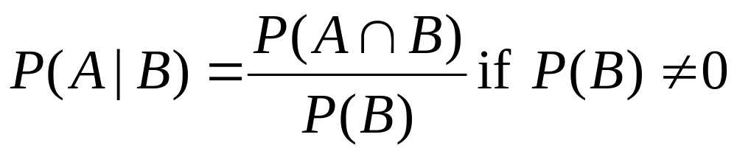
Conditional Probabilities
The probability that A occurs, given that event B has occurred is called the conditional probability of A given B and is defined as
“given”

Slide 33
Example 1
Toss a fair coin twice. Define
  A: head on second toss
  B: head on first toss
P(A|B) = ½
P(A|not B) = ½
HH
1/4
1/4
1/4
1/4
HT
P(A) does not change, whether B happens or not…
A and B are independent!
TH
TT

Slide 34
Example 2
A bowl contains five M&Ms®, two red and three blue. Randomly select two candies, and define
  A: second candy is red.
  B: first candy is blue.
m
P(A|B) =P(2nd red|1st blue)= 2/4 = 1/2
P(A|not B) = P(2nd red|1st red) = 1/4
m
m
m
m
P(A) does change, depending on whether B happens or not…
A and B are dependent!

Slide 35
Defining Independence
We can redefine independence in terms of conditional probabilities:
Two events A and B are independent if and only if
P(A|B) = P(A) or P(B|A) = P(B)
Otherwise, they are dependent.
Once you’ve decided whether or not two events are independent, you can use the following rule to calculate their intersection.

Slide 36
The Multiplicative Rule for Intersections
For any two events, A and B, the probability that both A and B occur is
P(A ∩ B) = P(A) P(B given that A occurred) = P(A)P(B|A)
If the events A and B are independent, then the probability that both A and B occur is
P(A ∩ B) = P(A) P(B)

Slide 37

Example 1
In a certain population, 10% of the people can be
classified as being high risk for a heart attack. Three people are randomly selected from this population. What is the probability that exactly one of the three are high risk?
Define H: high risk N: not high risk
P(exactly one high risk) = P(HNN) + P(NHN) + P(NNH)
= P(H)P(N)P(N) + P(N)P(H)P(N) + P(N)P(N)P(H)
= (.1)(.9)(.9) + (.9)(.1)(.9) + (.9)(.9)(.1)= 3(.1)(.9)² = .243

Slide 38
Example 2
Suppose we have additional information in the
previous example. We know that only 49% of the population are female. Also, of the female patients, 8% are high risk. A single person is selected at random. What is the probability that it is a high risk female?
Define H: high risk F: female
From the example, P(F) = .49 and P(H|F) = .08. Use the Multiplicative Rule:
P(high risk female) = P(H∩F)
= P(F)P(H|F) =.49(.08) = .0392

Slide 39
The Law of Total Probability
Let S₁ , S₂ , S₃ ,..., S_{k} be mutually exclusive and exhaustive events (that is, one and only one must happen). Then the probability of another event A can be written as
P(A) = P(A ∩ S₁) + P(A ∩ S₂) + … + P(A ∩ S_{k})
= P(S₁)P(A|S₁) + P(S₂)P(A|S₂) + … + P(S_{k})P(A|S_{k})

Slide 40
The Law of Total Probability
S₁
A
A ∩S_{k}
A ∩ S₁
S_{k}
S_{2….}
P(A) = P(A ∩ S₁) + P(A ∩ S₂) + … + P(A ∩ S_{k})
= P(S₁)P(A|S₁) + P(S₂)P(A|S₂) + … + P(S_{k})P(A|S_{k})

Slide 41
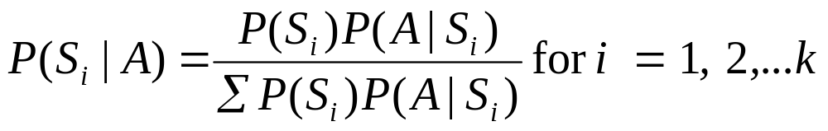
Bayes’ Rule
Let S₁ , S₂ , S₃ ,..., S_{k} be mutually exclusive and exhaustive events with prior probabilities P(S₁), P(S₂),…,P(S_{k}). If an event A occurs, the posterior probability of S_{i}, given that A occurred is

Slide 42
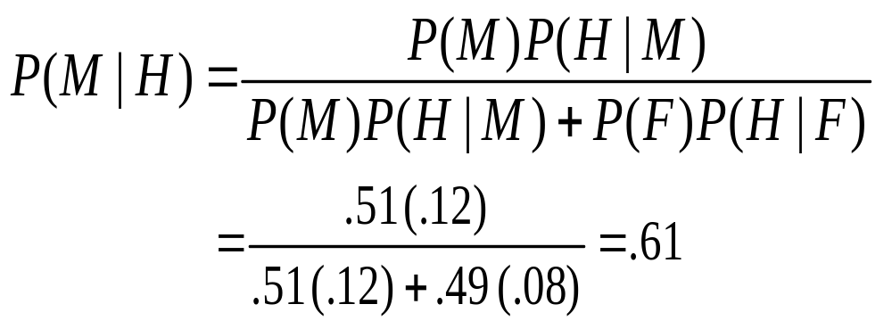
Example
From a previous example, we know that 49% of the population are female. Of the female patients, 8% are high risk for heart attack, while 12% of the male patients are high risk. A single person is selected at random and found to be high risk. What is the probability that it is a male?
Define H: high risk F: female M: male
We know:
P(F) =
P(M) =
P(H|F) =
P(H|M) =
.49
.51
.08
.12

Slide 43
Random Variables
A quantitative variable x is a random variable if the value that it assumes, corresponding to the outcome of an experiment is a chance or random event.
Random variables can be discrete or continuous.
Examples:
  x = SAT score for a randomly selected student
  x = number of people in a room at a randomly selected time of day
  x = number on the upper face of a randomly tossed die

Slide 44
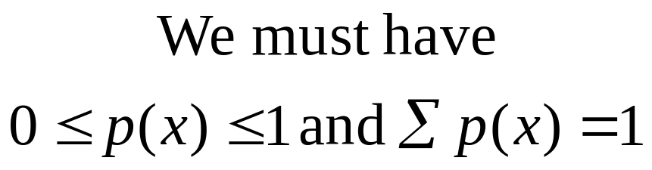
Probability Distributions for Discrete Random Variables
The probability distribution for a discrete random variable x resembles the relative frequency distributions we constructed in Chapter 1. It is a graph, table or formula that gives the possible values of x and the probability p(x) associated with each value.

Slide 45
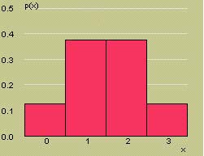
Example
Toss a fair coin three times and define x = number of heads.
x
3
2
2
2
1
1
1
0
HHH
x | p(x)
0 | 1/8
1 | 3/8
2 | 3/8
3 | 1/8
1/8
1/8
1/8
1/8
1/8
1/8
1/8
1/8
P(x = 0) = 1/8
P(x = 1) = 3/8
P(x = 2) = 3/8
P(x = 3) = 1/8
HHT
HTH
THH
HTT
Probability Histogram for x
THT
TTH
TTT

Slide 46
Probability Distributions
Probability distributions can be used to describe the population, just as we described samples in Chapter 1.
  Shape: Symmetric, skewed, mound-shaped…
  Outliers: unusual or unlikely measurements
  Center and spread: mean and standard deviation. A population mean is called μ and a population standard deviation is called σ.

Slide 47
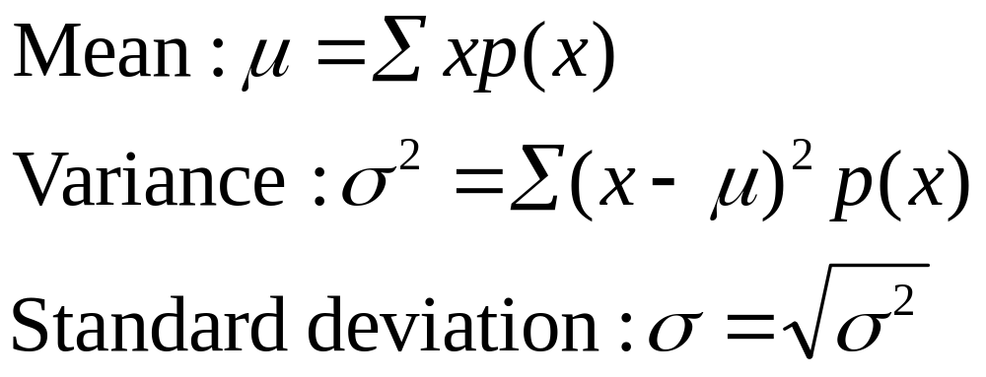
The Mean and Standard Deviation
Let x be a discrete random variable with probability distribution p(x). Then the mean, variance and standard deviation of x are given as

Slide 48
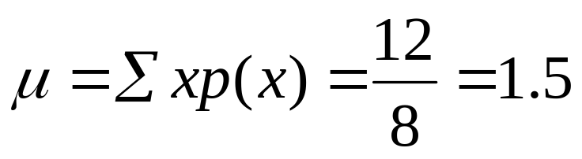
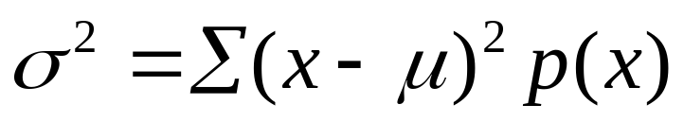
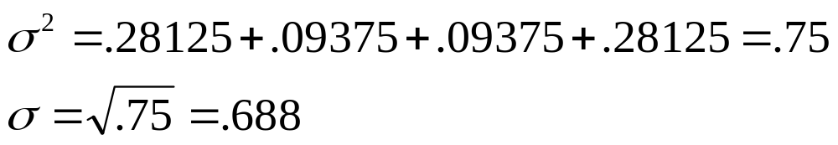
Example
Toss a fair coin 3 times and record x the number of heads.
x | p(x) | xp(x) | (x-μ)²p(x)
0 | 1/8 | 0 | (-1.5)²(1/8)
1 | 3/8 | 3/8 | (-0.5)²(3/8)
2 | 3/8 | 6/8 | (0.5)²(3/8)
3 | 1/8 | 3/8 | (1.5)²(1/8)

Slide 49
Example
The probability distribution for x the number of heads in tossing 3 fair coins.
Symmetric; mound-shaped
Shape?
Outliers?
Center?
Spread?
None
μ = 1.5
σ = .688
μ

Slide 50
Key Concepts
I. Experiments and the Sample Space
1. Experiments, events, mutually exclusive events,
simple events
2. The sample space
3. Venn diagrams, tree diagrams, probability tables
II. Probabilities
1. Relative frequency definition of probability
2. Properties of probabilities
a. Each probability lies between 0 and 1.
b. Sum of all simple-event probabilities equals 1.
3. P(A), the sum of the probabilities for all simple events in A

Slide 51
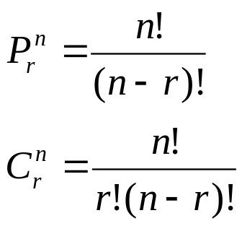
Key Concepts
III. Counting Rules
1. mn Rule; extended mn Rule
2. Permutations:
3. Combinations:
IV. Event Relations
1. Unions and intersections
2. Events
a. Disjoint or mutually exclusive: P(A ∩ B) = 0
b. Complementary: P(A) = 1 − P(A^{C} )

Slide 52
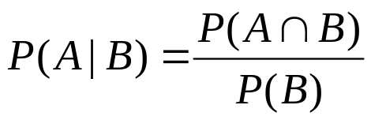

Key Concepts
3. Conditional probability:
4. Independent and dependent events
5. Additive Rule of Probability:
6. Multiplicative Rule of Probability:
7. Law of Total Probability
8. Bayes’ Rule

Slide 53


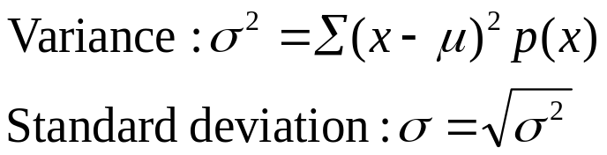
Key Concepts
V. Discrete Random Variables and Probability Distributions
1. Random variables, discrete and continuous
2. Properties of probability distributions
3. Mean or expected value of a discrete random variable:
4. Variance and standard deviation of a discrete random variable:

